Slide 1
UML—additional topics
Syntax for loops and conditional statements in sequence diagrams
Adding rationales to UML designs

Slide 2
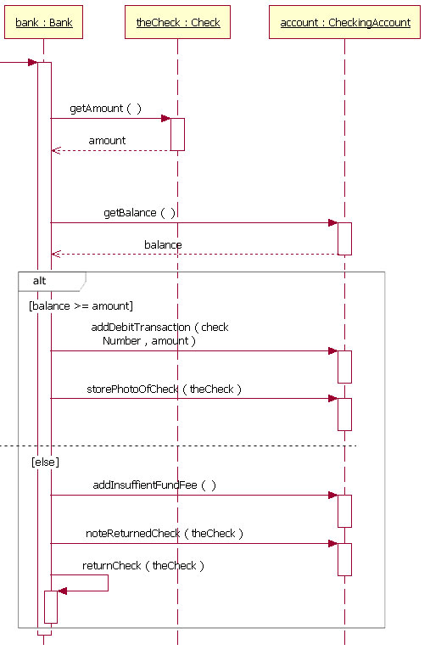
showing a conditional branch in a UML sequence diagram: http://stackoverflow.com/questions/8114770/how-to-show-if-condition-on-a-sequence-diagram

Slide 3
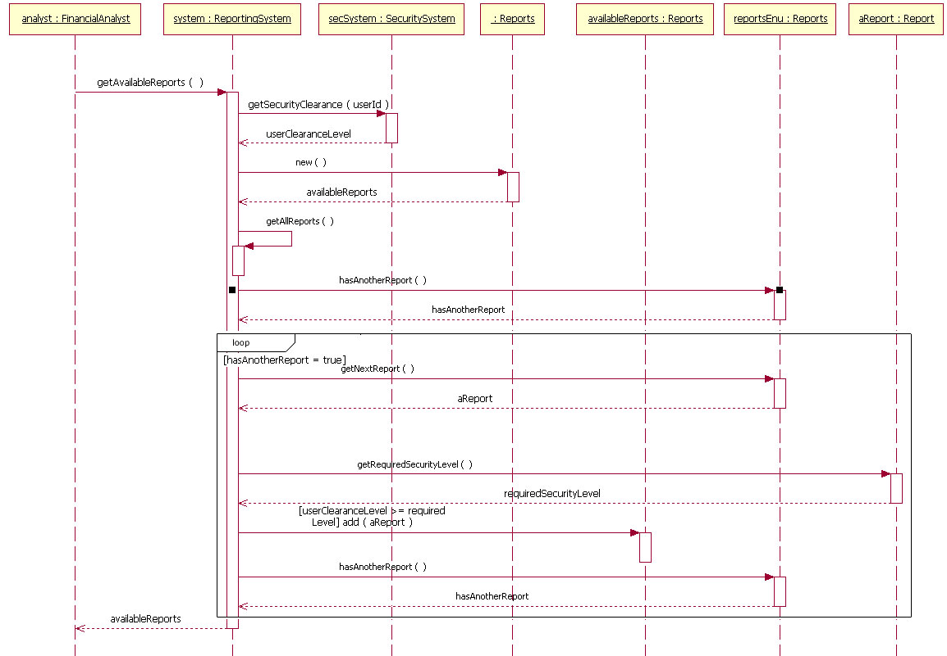
Looping in a sequence diagram: http://www.ibm.com/developerworks/rational/library/content/RationalEdge/feb04/3101_figure10.html

Slide 4
Design Analysis with UML;
Rationales: What were we thinking?

Slide 5
Example: vending machine
Requirements:
--Machine must be user friendly
--Machine must stand out in its environment
--Machine must be appropriate for its environment
(e.g., hospital)
--Machine must use minimal amounts of power
--Machine must be very reliable (failure < 1/90 days)
--Machine must be low-cost
--Machine must have “usual” features for accepting
payment, giving change, dispensing product, etc.
Some choices for design
flashing lights
voice-activated
“talking vending machine”
??????

Slide 6
Rationales
WHY were the decisions made in these examples, i.e., what was the rationale for each decision?
Can we capture the rationale and document it so that future developers can understand the thought process?
Example:
Why was there a possible Y2K problem, i.e., why were dates stored as two digits?—because developers chose a number format to save memory, which was expensive in the 50s and 60s

Slide 7
Parts of a Rationale
--what is the ISSUE to be dealt with?
--what are the ALTERNATIVES being considered?
--what CRITERIA are important in a solution—e.g., space, time, size, usability, etc.
--what are the ARGUMENTS which support each alternative?
--how is the DECISION arrived at, i.e., how do the arguments lead to the alternative chosen?

Slide 8
Capturing this process—choices
(part of the development process)
--No explicit capture—the process is preserved only in the memories of the developers and possibly in communications among them
--Reconstruction—during documentation, an attempt is made to justify choices made; discarded alternatives and discussion of alternatives are not saved; future developers must reconstruct the reasons for the choices based on the available evidence
--Rationale capture—for example, a graph whose nodes represent issue alternatives, and evaluation criteria can be constructed; this can be attached to the system design as appropriate
--Rationale integration—rationale models become central to the developers’ work; they form an information base for the company
Question: how do these choices fit with process maturity (CMM)?

Slide 9
Example: Security System-n digit code
Number of Tries Allowed to Enter Correct Code = X
Design Choices: n = ? X = ?
--No explicit capture—the process is preserved only in the memories of the developers and possibly in communications among them
--Reconstruction—during documentation, an attempt is made to justify choices made; discarded alternatives and discussion of alternatives are not saved
--Rationale capture—for example, a graph whose nodes represent issue alternatives, and evaluation criteria can be constructed; this can be attached to the system design as appropriate
--Rationale integration—rationale models become central to the developers’ work; they form an information base for the company

Slide 10
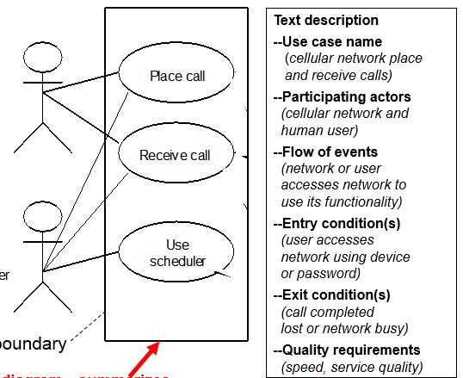
In-class TEAM Exercise
Please work on this exercise with your team. Turn in your work at the end of the class, be sure to put all team members’ names on what you turn in.
You have been asked to design a home security system. The system will have an n-digit passcode, and the user will have X chances to enter the code correctly. The system can be armed or disarmed using a keypad next to the main door or using a cell phone app remotely. The passcode can also be changed either through the keypad or using a cellphone app.
Give a use case for this system. Use the format given here.
Show a sequence diagram for this use case.
Give values for n and X. Give rationales for your decisions.

